Slide 1
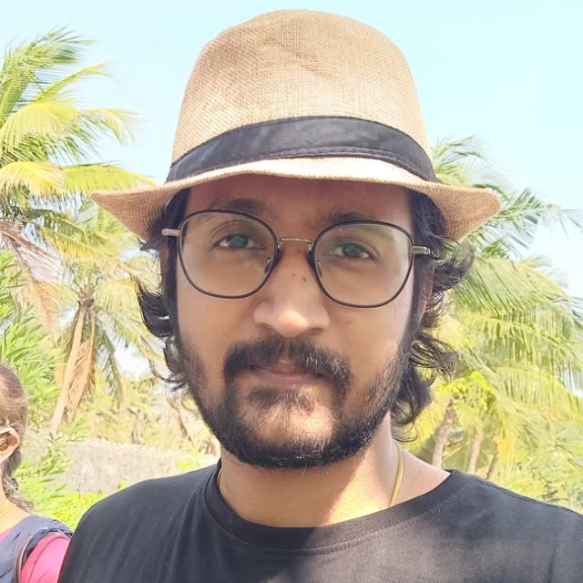
Hello!
I am Anand Subramanian with technology experience of 10 years. I work on technologies that deliver DevOps culture.
I enjoy sharing my knowledge.
I strongly believe Progress comes with Perseverance.

